Slide 1
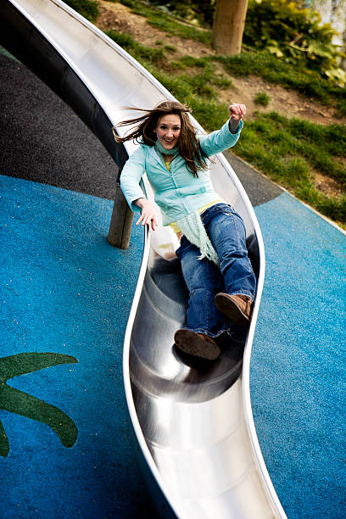
Do Now
Cameron and Frankie were playing on the slide, Frankie went down the slide quickly and smoothly. However, when Cameron went down the slide, he seemed to move much slower and occasionally stopped before reaching the bottom.
Why do you think Frankie slid down faster than Cameron?
What other factors would you want to observe or measure?
What forces might be at work when Frankie and Cameron go down the slide?

Slide 2
Observation
Using our senses
Inference
What we think is happening
Independent Variable
What is purposefully changed
Dependent Variable
What is measured
Controlled Variable
What is kept the same

Slide 3
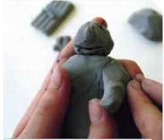

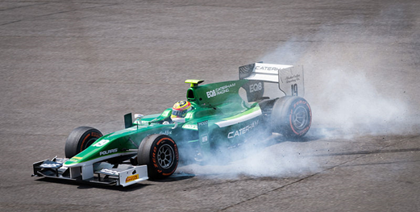
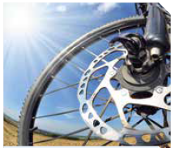
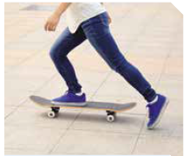
For each picture, describe what the force is doing.

Slide 4
Two students were interested in learning if coffee stays hotter for longer if you use a plastic cup or paper cup. For this experiment:
Independent variable
The cup’s material
Dependent variable
The coffee temperature
Controlled variables
The coffee itself, the coffee’s environment, whether milk was added
Write a hypothesis
The coffee in the plastic cup will stay hotter for longer

Slide 5
Contact and Non-contact Forces
Success Criteria
Describe forces as “contact” or “non-contact”
List examples of contact and non-contact forces
Explain the impact of contact and non-contact forces

Slide 6

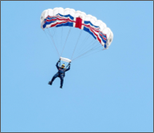

Describe forces as “contact” or “non-contact”
Forces are part of our daily lives as they make things move and stay still.​
Pushing and pulling are examples of forces acting to slow things down or speed them up.​
What ways can you think of forces acting on an object? Does a force always need to be touching an object to have an effect?​

Slide 7



Describe forces as “contact” or “non-contact”
A force is a push, pull or twist created when two objects interact.​
All forces (interactions) between objects can be placed into two groups:
Contact Forces
Non-contact Forces

Slide 8


Describe forces as “contact” or “non-contact”
Contact forces are forces that result when the two interacting objects are in physical contact.
Examples:​ | Non-examples:​
Two objects (e.g. fire-lighting sticks) rubbing against each other.​ ​ Boats float in water because the water is pushing up against the weight of the boat.​ | Two magnets being attracted to each other.​ ​ When you jump in the air and are pulled back towards the ground by gravity.​

Slide 9

Describe forces as “contact” or “non-contact”
Some forces are able to affect something from a distance. Non-contact forces are forces when the two interacting objects are not in physical contact.​
Examples:​ | Non-examples:​
Water balloon falling from above someone and gravity pulls it towards the ground.​ ​ Rubbing hair with a balloon and the hair becomes attracted to the balloon afterwards.​ | Opening a door with your hand.​ ​ Trying to run in thigh deep water and are slowing down from the water coming into contact with your legs.​ ​

Slide 10
Describe forces as “contact” or “non-contact”
Would the following examples involve contact or non-contact forces?​
A car using its brakes to slow down. ​
A skydiver falling towards the Earth.​
A basketballer making a slam-dunk.​
Making water bend using a rod without the rod touching the water.​
A tin can being attracted to a magnet.​
​
​
​
​

Slide 11
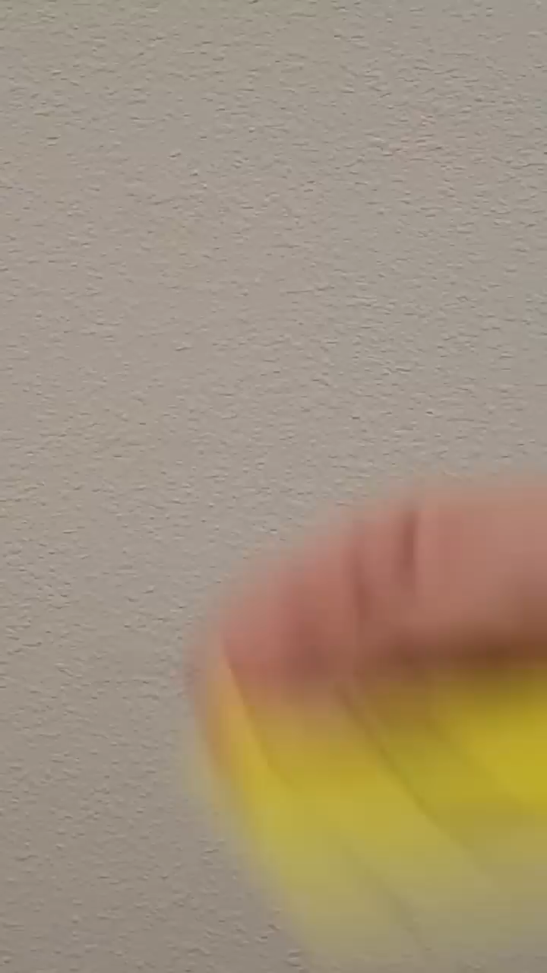
Brain Break
In this video, two of the facts shown are true, and the other is false. See if you can identify which is which before the end!
Notes:
https://www.youtube.com/shorts/HzNycRWlwTw if video doesn’t work

Slide 12

Describe forces as “contact” or “non-contact”
Watch closely!
Your teacher will play the following – take notes, you will be asked to share at least one thing you learned from the video!

Slide 13
List examples of contact and non-contact forces
There are many examples of forces with “names” that we experience in our daily lives. These include:
Buoyancy (allows an object to float on a fluid)
Friction (prevents an object from moving along another object)
Tension (force on a rope when pulled tightly)
Normal (force of the floor pushing up on us)
Gravity (pulls one object towards another)
Electrostatic (force between charged objects)
Magnetic (force between magnets)
Notes:
https://www.youtube.com/watch?v=NqdOyxJZj0U if video doesn’t work

Slide 14
List examples of contact and non-contact forces
Label each force as contact or non-contact:
Buoyancy (allows an object to float on a fluid)
Friction (prevents an object from moving along another object)
Magnetic (force between magnets)
Tension (force on a rope when pulled tightly)
Gravity (pulls one object towards another)
Electrostatic (force between charged objects)
Normal (force of the floor pushing up on us)

Slide 15

Brain Break
In this video, two of the facts shown are true, and the other is false. See if you can identify which is which before the end!
Notes:
https://www.youtube.com/shorts/5Kk60KdWVW8 if video doesn’t work

Slide 16
Explain the impact of contact and non-contact forces
Answer the following questions in your book.
A diver springs off of a board, lands in the pool, then floats to the top. What forces are they likely to experience at each stage?
You slide a book across a table, and it eventually comes to a stop.
What contact force causes it to slow down?
What force prevents the book from falling through the table?
Draw a balloon being held against the ceiling without being tied. Label all the contact and non-contact forces acting on the balloon.

Slide 17
Contact and Non-contact Forces
A force is a push, pull or twist created when two objects interact.​
All forces (interactions) between objects can be placed into two groups:
Contact Forces
Non-contact Forces

Slide 18


Contact and Non-contact Forces
Understanding forces allows us to understand why something will move or stay still. ​
For example, the non-contact force of gravity affects our whole planet.​
Our better understanding of forces has led to many scientific advancements. ​
This includes astronomers using their understanding of forces to launch satellites, and maintain their movement in space.​

Slide 19
Contact and Non-contact Forces
Success Criteria
Describe forces as “contact” or “non-contact”
List examples of contact and non-contact forces
Explain the impact of contact and non-contact forces

